Slide 1
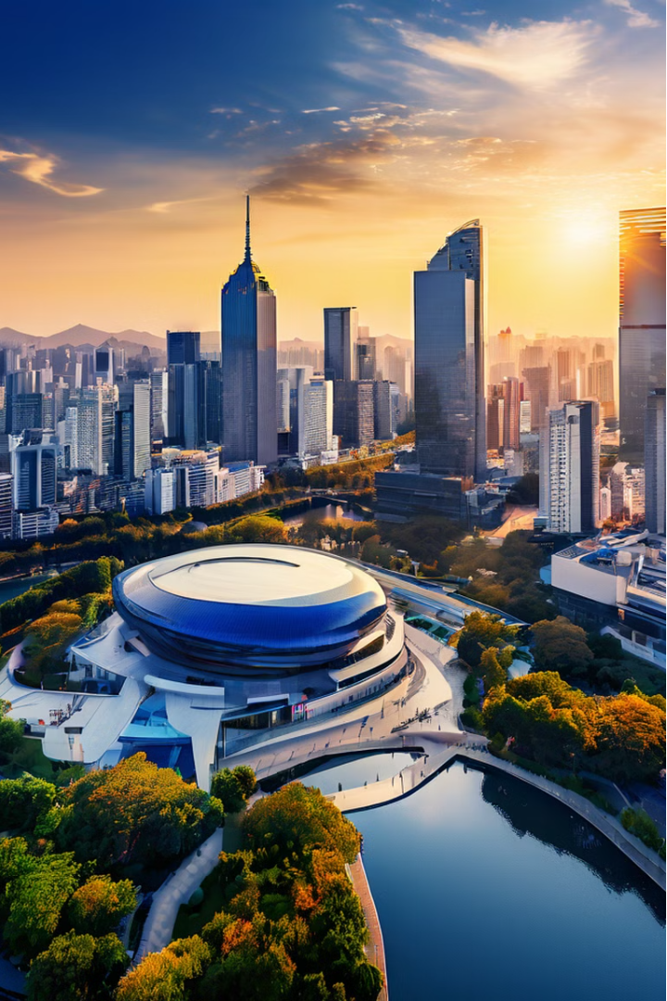

We Live in Nanjing
This book, "We Live in Nanjing", is a captivating science fiction novel that takes readers on a journey through time and space. Written by the talented author Tianrui Shuofu, this book blends elements of Chinese culture and futuristic storytelling to create a unique and engaging reading experience.
by xiangyu Chen

Slide 2
Main Characters
Bai Yang
Banxia
Bai Yang is a high school student in Nanjing in 2019. He is curious, brave, and determined to uncover the truth about the impending disaster that threatens the world.
Banxia is a young woman living in the post-apocalyptic world of 2040. She is a survivor, facing the challenges of the ruined Nanjing with resilience and a desire to change the course of the future.

Slide 3

Story Synopsis
1
2019 Nanjing
The story follows the life of Bai Yang, a high school student in Nanjing in the year 2019. Curious and brave, Bai Yang unexpectedly makes contact with a girl named Banxia, who is living in the year 2040.
2
2040 Nanjing
Banxia is a survivor in the post-apocalyptic world of 2040, where Nanjing has been reduced to ruins. Through their radio communication, Bai Yang and Banxia work together to uncover the secrets of the impending disaster and try to change the course of the future.
3
Saving the World
The story explores the challenges and dangers faced by the two characters as they navigate the unknown, while also delving into the themes of human resilience, responsibility, and the power of hope in the face of overwhelming odds.

Slide 4
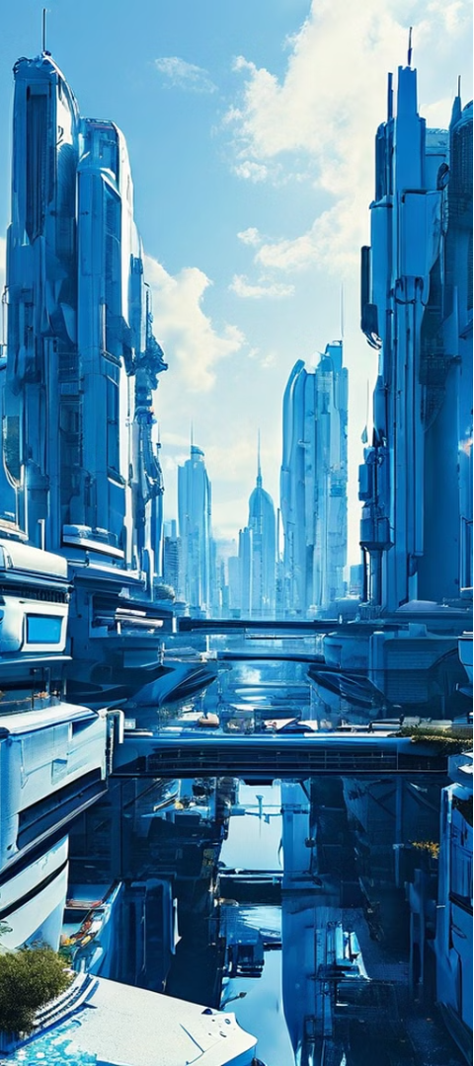
Story Setting
1
Time Span
2
Apocalyptic Nanjing
The story spans 21 years, connecting the present-day Nanjing of 2019 with the post-apocalyptic world of 2040.
In the year 2040, Nanjing has been reduced to a wasteland, with the city's inhabitants facing a dire and uncertain future.
3
Connecting the Eras
The story's unique setting allows for a captivating exploration of the challenges and possibilities that arise when two vastly different time periods collide.

Slide 5

Reader Praise and Awards
Reader Praise
Awards and Accolades
Readers have praised the novel for its creative premise and the sense of tension and suspense that permeates the story. Many have commented on the book's ability to blend science fiction elements with a grounded, relatable narrative.
The novel has been recognized for its excellence, winning the prestigious Xingyun Award for Best Chinese Science Fiction Novel and receiving critical acclaim from experts in the field.

Slide 6
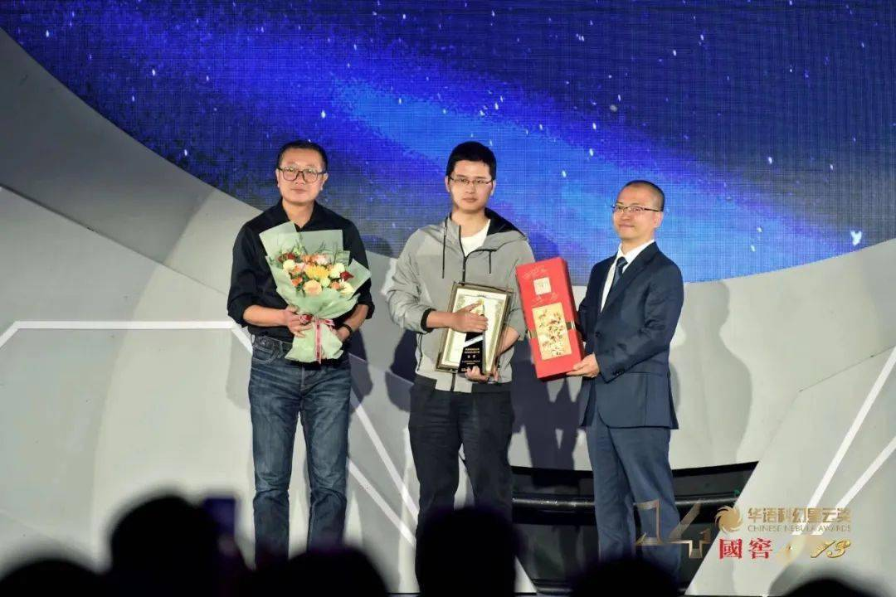
Expert Perspectives
Literary Perspective
Science fiction author Wu Yan praised the novel's unique approach, noting that it departs from traditional apocalyptic narratives by infusing the story with a more lighthearted and youthful spirit.
Cinematic Potential
Professor Wang Hongwei from the Beijing Film Academy highlighted the story's potential for adaptation, stating that the young protagonists and their struggles could provide fresh and compelling material for Chinese cinema.

Slide 7
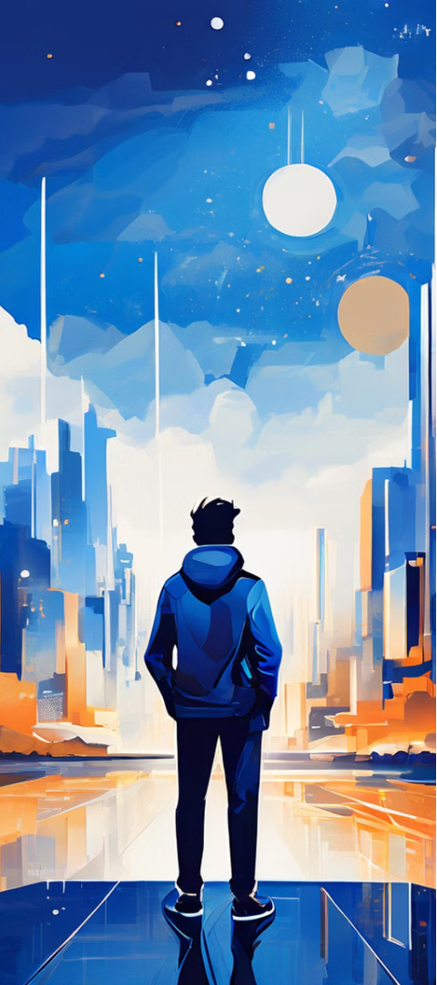
Themes and Highlights
1
Blending Cultures
2
Exploring Humanity
The novel skillfully combines elements of Chinese culture and science fiction, creating a unique and engaging reading experience that resonates with a wide audience.
At its core, the story delves into the themes of human resilience, responsibility, and the power of hope in the face of overwhelming challenges.

Slide 8
